Slide 1
Wynne’s Tour & Project Management

Slide 2

Communication
Regular Meetings
Email
Facebook
Text Messaging
Notes:
To work in a team effectively the group must have great communication. Not only does good communication help everyone understand their role, it also makes it much easier to track progress, stay efficient and discuss any problems which may arise.
We had a range of different ways to communicate, the one we used was dependant on the context of the message and the response time required.

Slide 3

Meetings
Discussed during meetings
Planning
Designing/Brainstorming
Allocating Tasks
Setting next meeting date/time
Notes:
Face to face has to be one of the most effective ways of communication, this is why we had regular meetings in order to effectively discuss the project within the whole team.
Upon the first meet we decided to find out each individuals strengths, this then gave us a great basis on how to divide up the multiple tasks to the right people.
Although this is a great way to communicate, it does have some downfalls. Finding an appropriate time in which each member can meet proved challenging at first, which is why we relied on alternate ways to communicate until a time came where most people could meet up.

Slide 4

Facebook
Communicating Through Facebook
Reminders to attend meetings
Discuss small queries
Share information
Notes:
As a group we opted to communicate mainly via Facebook, this is because it has numerous benefits for our particular situation.
Facebook messages are instantly received on a range of devices, this allowed us to communicate almost instantaneously.
In addition to this Facebook also provides a group chat feature which was very beneficial as it allowed to whole group to communicate at the same time.
Also, we were able to keep track of the conversation as Facebook logs all messages which we could referee back to at a later date.

Slide 5
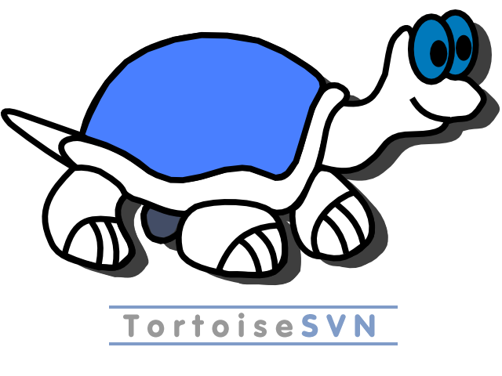
Svn (subversion repository)
Sharing Work
Sharing work documents
Collaborative workspace
Keeping track of project
Notes:
When communicating our software with each other we used SVN. This enabled the group to commit work to a repository and work on the project at the same time.
Another great benefit of SVN is the fact that each member could access all of the software remotely from home allowing anyone to add documents at any given time.

Slide 6
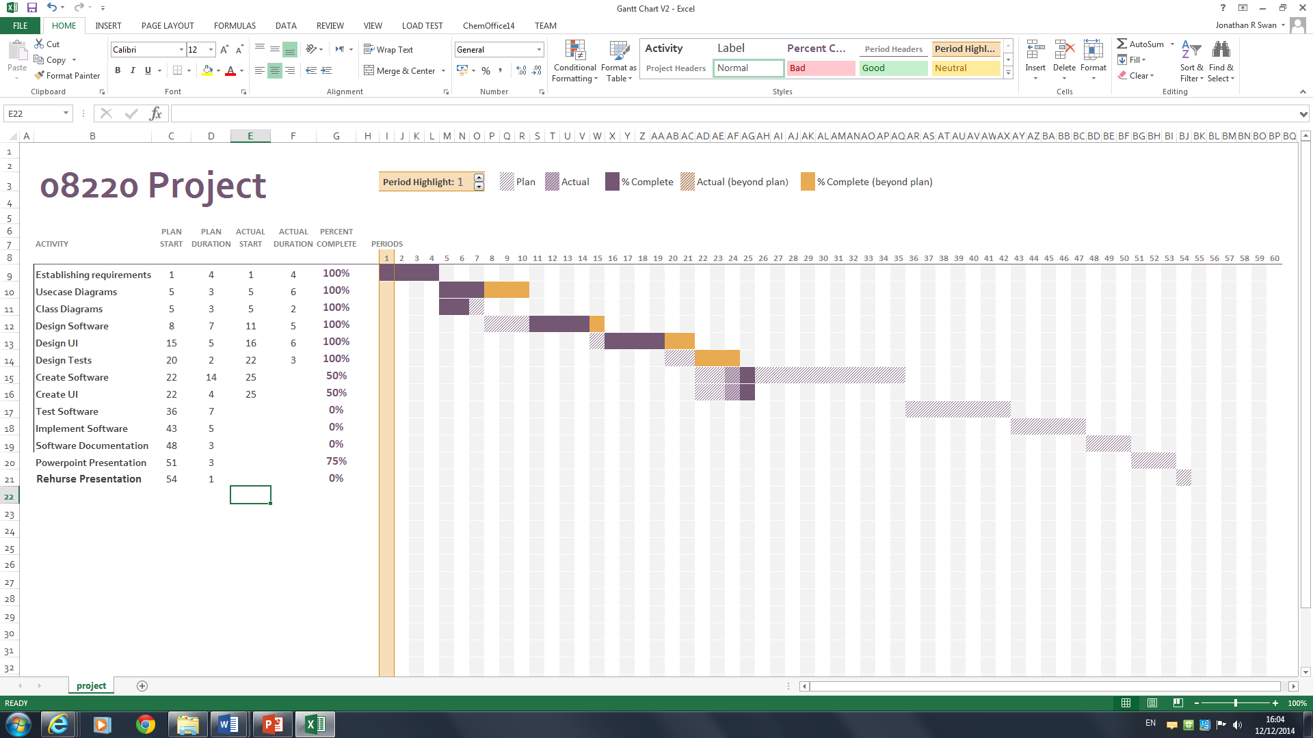
Gantt chart
Notes:
When making software it is very hard to track progress without the right tools and can make managing a software project hard work. Fortunately there are ways around this problem which helped the group understand how far we are through the project and, how close we were to the deadline. This came in the form of a Gantt Chart.
To help keep track of our project we used a Gantt Chart, this enabled the full group to update the chart upon completing an element of the project. Not only did this allow each member of the group to understand where we are within the project, it also showed each member if we were falling behind or in ahead of schedule. Finally it allowed us to gauge how close the deadline was approaching and if we had to increase or decrease our efforts to finish in time. The Gantt chart proved very beneficial in tracking the progress of out project.

Slide 7
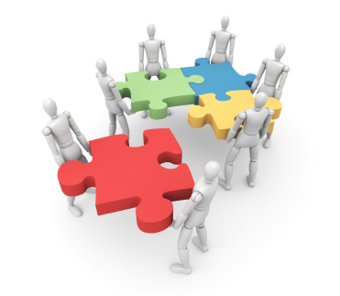
Group Contributions
Tasks were assigned to each member to complete
Some tasks were shared between the team
Members improved on completed tasks uploaded to SVN
Notes:
We had no problem with getting group members to contribute.
Everyone was enthusiastic to get involved and tasks were assigned without hassle.
All group contributions were uploaded to the SVN to be reviewed by team members and suggest improvements, if possible.

Slide 8
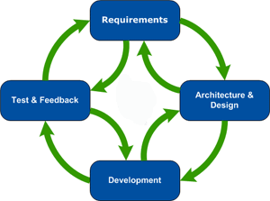
Software Development process
Agile Model
Notes:
We First identified individual tasks and tasks weren’t dependable
The general order we started tasks in
Completed activity diagrams
Completed Class Diagrams
Designed the User Interface
Implemented Software
Generate various documents
We used an agile development process so that when tasks are completed, they were exported to the SVN and team members could implement the work.
We started with the fundamentals like getting the requirements and designs done. The rest of the work was done in a very agile way / constantly making changes.

Slide 9
Any Questions?

